Slide 1

Microsoft Azure AI What is The Latest & Future Roadmap
Agenda Azure AI Introduction
What is New?
Demos – Speech, Local Models, Agents
Where to find New Innovations
Azure AI Roadmap Considerations
Bart Czernicki
Principal Global Black Belt | Artificial Intelligence
Email: bczernicki@microsoft.com
LinkedIn: https://www.linkedin.com/in/bartczernicki/
Twitter (X): https://twitter.com/bartczernicki
GitHub: https://github.com/bartczernicki
Version: October 2024

Slide 2










Microsoft Azure AI
Where innovators are creating the future
Azure OpenAI Service
Azure AI Vision
Azure AI Search
Azure AI Speech
Azure AI Document Intelligence
Azure AI Translate
Azure AI Content Safety
Azure AI Language
Azure Machine Learning
Notes:
In Azure many AI services are available, from translation to speech, to document intelligence.

Slide 3









Azure AI
Best-in-class AI foundation models
Azure AI Services
Pre-trained, turnkey solutions for intelligent applications
Azure Machine Learning
Full-lifecycle tools for designing and managing AI models
Responsible AI Tooling
Build and manage apps that are trustworthy by design
Azure AI Studio
A comprehensive platform to develop and deploy custom copilots
Notes:
Let’s explore the core components of Azure AI, which are designed to provide best-in-class AI foundation models.
Azure AI brings together several powerful tools and services:
Azure AI Services: These pre-trained, turnkey solutions allow you to add intelligent capabilities to your applications quickly and easily.
Azure Machine Learning: This platform offers comprehensive tools for designing, training, and managing AI models, supporting you through the entire lifecycle of AI development.
Responsible AI Tooling: Ensuring your AI applications are trustworthy by design is crucial. These tools help you build and manage ethical, transparent, and accountable AI solutions.
Azure AI Studio: At the heart of it all, this comprehensive platform allows you to develop and deploy custom copilots, providing a seamless experience for creating AI solutions tailored to your needs.
Together, these components create a robust ecosystem that empowers you to innovate and develop intelligent, responsible, and highly customized AI applications with ease. Azure AI equips you with the necessary tools to drive impactful solutions.

Slide 4

Azure AI model breadth
Offering a wide collection (1,700+) of frontier and open models
Azure OpenAI Service
Phi models
Meta
Mistral AI
Cohere
GPT-4o
Phi-3-mini
Llama-2-70b/70b-chat
Mistral Large
Cohere R+
GPT-4-Turbo with Vision, GPT-4, GPT-3.5
Phi-3-small
Llama-2-13b/13b-chat
Mistral 7B
Cohere R
Embeddings
Phi-3-medium
Llama-2-7b/7b-chat
Mixtral 8x7B – Mixture of Experts
Embed v3-Multilingual
DALL·E
Phi-3-vision
Llama-3
Embed v3-English
Whisper, Text to speech
CodeLlama
Hugging Face
Databricks
NVIDIA
Snowflake
Falcon/TII
Databricks/dbrx-base
Nemotron-3-8B-4k
Snowflake/arctic-base
Stable Diffusion/Stability AI
Databricks/dbrx-instruct
Nemotron-3-8B-Chat-SFT/RLHF/ SteerLM
Snowflake/arctic-instruct
Dolly/Databricks
Nemotron-3-8B-QA
CLIP/OpenAI

Slide 5
Azure AI Studio – Generally Available
Generally available
Azure AI Studio
A comprehensive platform to develop and deploy custom AI Applications
API and model choice
Complete AI toolchain
Responsible AI tools and practices
Enterprise-grade production at scale
ai.azure.com
Notes:
For those of you who are not familiar with Azure AI Studio, this tool is the unified hub to build AI applications in Azure and explore Azure AI features. The Playground within the studio – that we are going to use throughout the lab – offers a GUI to access Azure OpenAI services and interact with these models using different modalities.

Slide 6
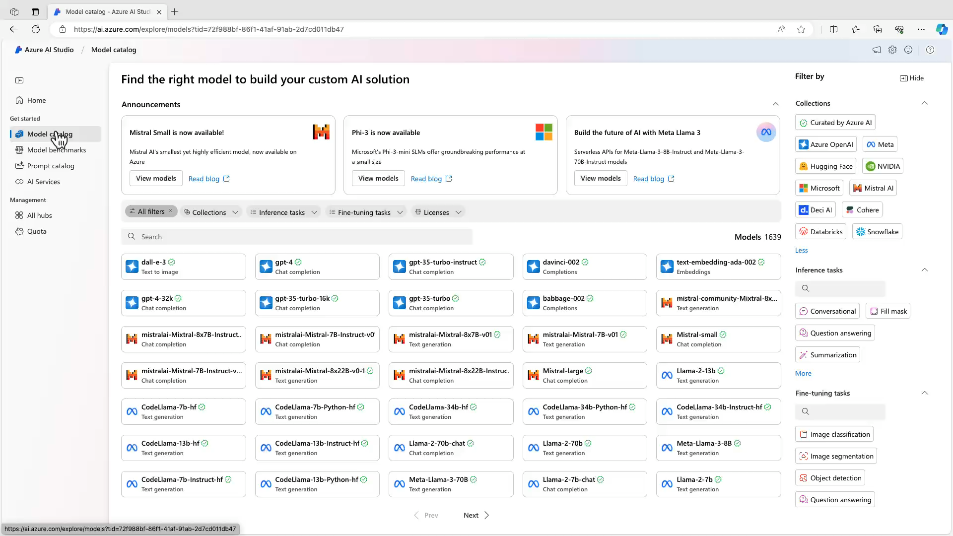
Notes:
Demo guidance: https://github.com/microsoft/aitour-generative-ai-in-azure/tree/main/train-the-trainer/multimodal

Slide 7
What is New?
Update on the Latest Announcements

Slide 8
Azure AI Updates
Latest Updates as of October 2024
1
OpenAI GPT-4o-mini-Model
Leading Cost/Performance
6
OpenAI o1 Series Models
Unlock Deeper Reasoning & Decision Intelligence
2
Microsoft Teams Integration
Deploy AI Experiences into Teams
7
AutoGen vNext Open Source
Enterprise & Scalable AI Agents
3
Global Batch Deployments
Optimize Costs by 50% using GenAI Jobs
8
Microsoft Phi 3.5 Refresh & MoE
Microsoft Open Source that are Commercial Ready
4
OpenAI GPT-4o-2024-08-06 Model
100% Adherence to JSON Output
9
Global Provisioned & Azure Data Zones
Optimize AI Traffic Orchestration & Deployment
5
Self-Service Provisioning
Managed AI Deployments in Portal or with APIs
10
OpenAI Real Time API (Audio)
Native Speech-To-Speech Paradigm

Slide 9

Speech To Speech Demo
Realtime Audio API
https://www.youtube.com/watch?v=vXJka8xZ9Ko
https://github.com/Azure-Samples/aisearch-openai-rag-audio
https://github.com/Azure-Samples/aoai-realtime-audio-sdk

Slide 10
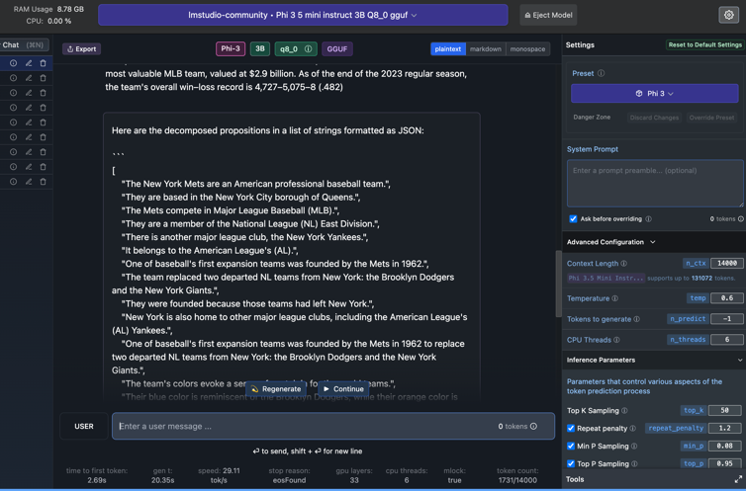
Run AI Models on Non-Cloud Hardware
LM Studio Running Phi 3.5 on MacOS
https://lmstudio.ai/

Slide 11
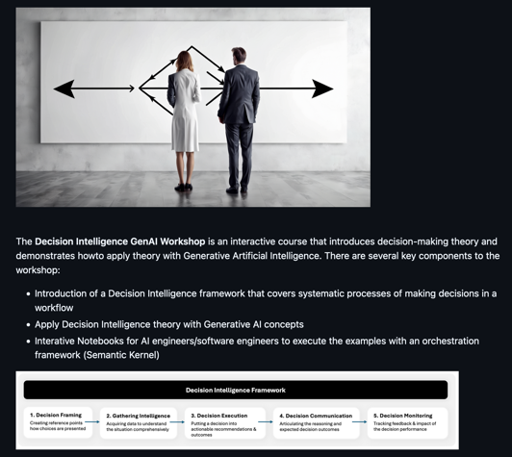
Decision Intelligence Workshop
Digitize Decision-Making with AI
https://github.com/bartczernicki/DecisionIntelligence.GenAI.Workshop

Slide 12
Find Azure AI Updates Like a Pro
Where can I ”keep up” with the Latest on Azure AI?
Azure AI Studio (Continuous Updates, Private Previews, 1st Day Launch with OpenAI)
https://ai.azure.com
What is New in Azure OpenAI Service (Continuous Updates of what is new the Azure OpenAI Service)
https://learn.microsoft.com/en-us/azure/ai-services/openai/whats-new
Azure AI Services Blogs (New Updates from AI Engineering & AI Technical Field)
https://techcommunity.microsoft.com/t5/ai-azure-ai-services-blog/bg-p/Azure-AI-Services-blog
Azure OpenAI Service Model Deprecations & Retirements
https://learn.microsoft.com/en-us/azure/ai-services/openai/concepts/model-retirements
Well Architected Framework (WAF) 2.0 (Best Practices on Implementing AI Solutions)
https://learn.microsoft.com/en-us/azure/well-architected/whats-new
Azure AI Samples on GitHub (Collection of Repositories with new AI Capabilities)
https://github.com/Azure-Samples/azureai-samples

Slide 13


Roadmap Starts with Best Friends
Ensure that artificial general intelligence (AGI) benefits humanity
Empower every person and organization on the planet to achieve more
Azure OpenAI Service
Language
Multi-Modal
Fine Tuning
Images
Transcription & Audio
GPT-4o, o1,
GPT-4-Turbo with Vision
GPT-4,GPT-4o, GPT-4o-mini,
GPT-3.5-Turbo
GPT-4, o1, GPT-4o 3.5-Turbo
Whisper
Realtime Audio
DALL·E 3
On Your Data GA
Azure AI Studio GA
Assistants API Preview
Provisioned Throughput
Notes:
Narrative/talk track:
The MSFT / OpenAI partnership and how we collaborate
Microsoft has formed a partnership with OpenAI to collaborate on the development of artificial intelligence technologies. The partnership aims to accelerate the development of advanced AI systems and bring the benefits of AI to more people.
As part of the partnership, Microsoft and OpenAI have agreed to work together on several key areas, including:
Developing AI technologies: The two companies will collaborate on the development of new AI models and algorithms, with a focus on natural language processing, computer vision, and other areas of AI.
Building an AI computing platform: Microsoft and OpenAI will work together to build a new AI computing platform that will allow developers to easily access and use advanced AI models and algorithms.
Advancing AI research: The two companies will also collaborate on a range of research projects aimed at advancing the state of the art in AI.
Making AI more accessible: The partnership aims to make AI more accessible to a wider range of developers and organizations, in order to bring the benefits of AI to more people.
Microsoft has also announced it will use OpenAI's GPT-3 technology to add more capabilities to its products such as Cortana, Power Virtual Agents and Dynamics 365.
Additionally, Microsoft has also made an investment in OpenAI, allowing the company to use Microsoft Azure as its preferred cloud platform, and allowing OpenAI to tap into the vast resources of Microsoft to accelerate its research. This partnership gives OpenAI the ability to scale its models and services on Azure and make them more widely available to customers.
Overall, the partnership between Microsoft and OpenAI aims to accelerate the development and use of advanced AI technologies, with a focus on making AI more accessible to developers and organizations, in order to bring the benefits of AI to more people.

Slide 14
Azure AI - Fast Follow Roadmap
Same Day in Azure AI Studio Playground or ~2 Weeks for API
Examples of OpenAI Releases that Are or Potentially Fast Following to Azure
Introducing the Realtime API (ChatGPT Advanced Mode)
https://learn.microsoft.com/en-us/azure/ai-services/openai/how-to/audio-real-time
Vision Fine-Tuning API
https://openai.com/index/introducing-vision-to-the-fine-tuning-api/
Prompt Caching in the API
https://openai.com/index/api-prompt-caching/
API Model Distillation
https://openai.com/index/api-model-distillation/
ChatGPT Canvas (New way to write code)
https://openai.com/index/introducing-canvas/
Scaling AI Applications Best Practices
https://github.com/bartczernicki/ArtificialIntelligence-Presentations/tree/master/GenAI/ScalingGenerativeAI

Slide 15




AI Scaling Optimizations
Accuracy
Latency
Cost
AI Model Selection
AI Model & Provider Selection
Prompt Optimization
Model Deployment Types
Model (API) Parameters
Minimize Input (Prompt) Tokens
Shorter Model Context Windows
Minimize Output Tokens
RAG
Prompt Caching (OpenAI API)
Azure AI Groundedness
Transformer KV Caching
AI Lifecycle Management
Evaluation Driven Development
Prompt To Completion Ratio
AI Partner Management
OpenAI Logprobs
Persisted Authoritative Responses
GenAI Platform Strategy
Model Fine-Tuning
Model Request Orchestration

